Slide 1
Github
Contribute code to landsandboat github repository
Notes:
Instructor Introduces themselves. And welcomes the students to the self pace e-learning course.
This course should take approximately 1 hour to complete, excluding the assessment at the end.
Next slide

Slide 2
Icebreaker Video demonstration of code in work
Notes:
Instructor prefaces that we will not be teaching HOW TO CODE but rather how to contribute to the LSB project via github. However, the video demonstration will show the rewards of how coding can alter the video game project.
Next slide

Slide 3
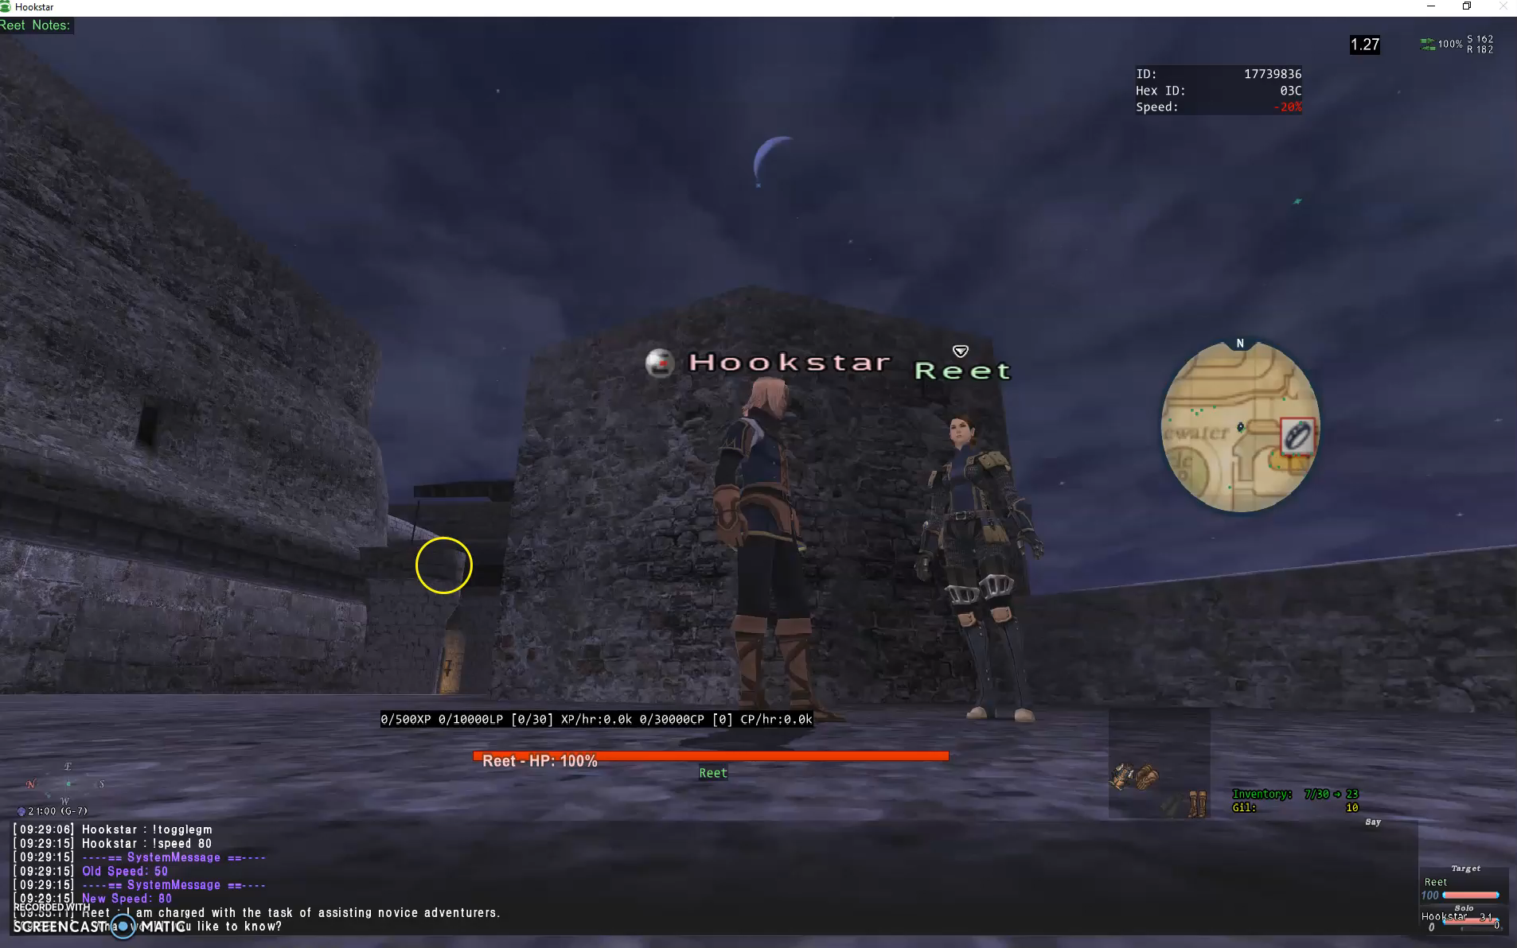
Notes:
Watch the video – click once complete.
Notice the player got 50 gil (money) from the first trade. Once the code was modified, the player got 5,000,000 for turning in the same item. If the correct amount was supposed to be 5mil, the learner in this course would make the modifications in their branch and push to the main LSB repository so all the servers would be correct.

Slide 4
Learner prerequisites
Learner should have a working knowledge of how to download and install software from a provided list
Learner should have access to the following technologies
Personal Computer
Reliable High-Speed internet connection
Adequate hard drive storage space (~2TB)
Headphones or speakers
Notes:
Instructor will explain the requirements and specifications for this module.

Slide 5
Prepare for combat; Task List & Outcomes
Install required files
Navigate to www.github.com
Create Account
Fork account
Create a branch of forked repository
Modify file(s). Commit using GitHub desktop
Create Pull Request from website
Delete Branch
Student Assessment
Notes:
Instructor will read the agenda of what this module will cover.

Slide 6
Outcome #1
Install THESE FILES
Notes:
Instructor will provide the download list for the 3rd party software. Learner will install on their own and pick back up when they are complete with the install.

Slide 7
Outcome #2
Navigate to www.github.com
Create Account
Notes:
Instructor will navigate and the learner will follow along to create a GitHub account if not already created.

Slide 8
Outcome #3
Fork test repository at hooksta4/refactored-octo-broccoli: A simple broccoli living in a simple LTLE610 world. (github.com)
Create a branch of forked repository
Clone repository to local machine
Make changes to modify.md in Student Practice Folder using notepad ++ on local machine, save changes.
Notes:
Instructor will explain that instead of going straight to the LSB working repository, we will practice using a test repository. Stressing that all the steps will be the same for LSB.
Instructor will guide the learner through forking and branching the repository. As well as cloning the repository to the learners local machine.
Learner and instructor will modify the file modify.md in the Student Practice Folder.

Slide 9
Outcome #4
Open GitHub desktop app, login using your GitHub account.
Add repository and ensure correct branch is listed.
Left window will show files modified. Give commit name (bottom left) and description.
Commit and Push to Origin (If asked, select contribute)
Go to Compare · hooksta4/refactored-octo-broccoli (github.com)
Create Pull Request Base: main ← Compare: YOURBRANCHNAME
Delete branch once PR is merged (You will get a notification)
Navigate back to Main Branch
Fetch and merge to bring changes current to your main. (this updates your forked repository to be at the same place as the main repository.
Notes:
Instructor will lead the learners to open the GitHub desktop Application where they will see their changes listed. Instructor will explain the Commit and push to orgin function. Learner will commit and push to their branch of the forked repository. Learner and Instructor will then go to github.com and create a pull request.
Instructor will then express the importance of cleanup – that is ensuring the learners fork is even with the main repository. This is done by Fetch and Merge.

Slide 10
assessment
Create new branch named “Assessment_Lastname” from forked repository
Clone repository as Assessment_Lastname on local system
Open modify.md in Student Assessment folder; follow instructions
Save and close. Create a new folder in Student Assessments, name the folder your last name.
Create a text file with your favorite movie quote.
Open Github Desktop, Add repository (navigate to Assessment_Lastname)
Input Commit name and description.
Push to branch
Create pull request from website.
Delete branch once merged.
Notes:
Students will be given conditions to create a new pull in a different folder than the previous example(s). This is going to be assessed by the instructor as they will get a notification when a new Pull Request is created.
Students will be given immediate feedback in the form of change requests (something was wrong or missing) or competition status when the Pull Request is merged.

Slide 11
Conclusion
Learners were successfully able to
Create new branch from forked repository
Clone repository on local system
Open/Create/Modify files
Create Commits
Push to branch
Create pull request from website
Delete branch once merged
Notes:
Instructor reviews tasks completed and thanks learners for attending the class.
Happy coding.

